Slide 1
Face Recognition
Presenters: Shikhar Malhotra, Pranav Bhat, Pranav Sodhani, Atishay Aggarwal, Ameya Kabre

Slide 2
Definition
Face recognition system is a computer application capable of identifying or verifying a person from a digital image
Notes:
or a video frame from a video source
Forensics and surveillance work

Slide 3
Successful systems in place
Apple uses advanced deep learning techniques to bring facial recognition to iPhone; Only uses local data which doesn’t require storing of faceprints on company servers
Systems like Google’s FaceNet and Facebook’s DeepFace have made their way into web platforms, making it easier for users to tag photos and search for people
Notes:
100% and 97% accuracy on Labelled Faces in the wild

Slide 4
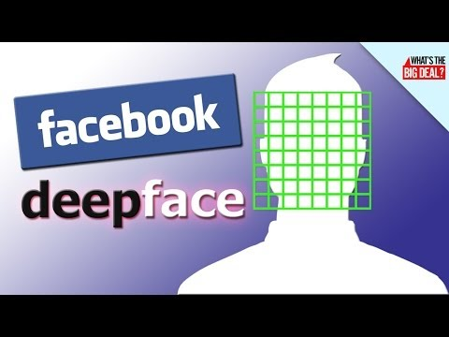

Slide 5
Deep Face Recognition
Omkar M. Parkhi, Andrea Vedaldi, Andrew Zisserman
http://www.robots.ox.ac.uk:5000/~vgg/publications/2015/Parkhi15/parkhi15.pdf

Slide 6
Objectives
Building a large scale dataset (2.6M images over 2.6K people), assembled by a combination of humans and automation
Propose a Convolutional Neural Network which can compete with state of the art methods and Internet giants such as Google and Facebook

Slide 7
Dataset Collection
Bootstrapping and filtering list of candidate identities
Focus on celebrities and politicians, easily available on internet
Internet Movie Data Base (IMDB) celebrity list
5000 identities reduced to 3,250, by setting 90% purity bar for 200 images per candidate
Lack of purity due to image scarcity

Slide 8
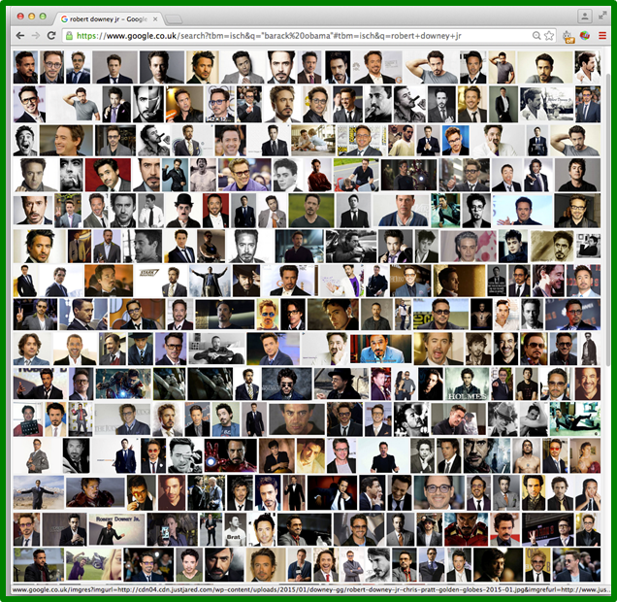
Dataset Collection
Bootstrapping and filtering list of candidate identities
Robert Downey Jr.

Slide 9

Dataset Collection
2. Enhancing dataset by collecting more images
2000 images per identity (2,622 celebrity names)
Searching by appending keyword “actor”

Slide 10
Dataset Collection
3. Improving purity with automatic filter
Remove erroneous images from each set using a trained classifier
Linear SVM ranks 2000 images, top 1000 retained
4. Removing near duplicates
Images differing in colour balance or with text superimposed are removed
Clustering images and retaining one image per cluster

Slide 11
Dataset Collection
5. Manual filtering
Multi-way CNN is built to discriminate between 2,622 face identities
Ranked images displayed in blocks of 200, purity greater than 95%

Slide 12
Dataset Statistics after each stage
No. | Aim | Mode | # Persons | # images /person | Total # images | Anno. effort
1 | Candidate list generation | Auto | 5000 | 200 | 1,000,000 | -
2 | Collecting more images | Manual | 2622 | 2,000 | 5,244,000 | 4 days
3 | Rank image sets | Auto | 2622 | 1000 | 2,622,000 | -
4 | Near duplicate removal | Auto | 2622 | 623 | 1,635,159 | -
5 | Manual filtering | Manual | 2622 | 375 | 982,803 | 10 days
Notes:
4.4 M of facebook, 200 M of google

Slide 13
Network Architecture and Training
The face recognition problem was modelled as a N-way classification problem.
The authors used a deep convolutional neural net, to associate with each image a score vector (1024 Dimensions, unit distance)
These score vectors were compared to ground truth class identity by calculating empirical soft-max log loss.

Slide 14
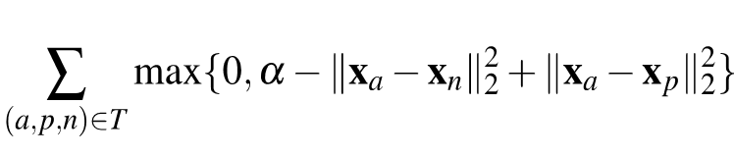
Network Architecture and Training
The score vectors were improved using a “triplet embedding” scheme.
Learn a projection which is distinctive and compact, achieving dimensionality reduction at the same time
The projection W’ is trained to minimise the empirical triplet loss -

Slide 15
Network Architecture and Training
CNN architecture A has 11 blocks, first 8 are set to be convolutional and the last 3 blocks are called Fully Connected (FC)
First two FC layers have 4096 dimensional outputs, while the last FC layer has 1024 dimensions
B and D networks have 2 to 5 additional convolution layers respectively
Input is face image of size 224x224
Notes:
Learning a projection from 4096 to 1024 dimensions

Slide 16
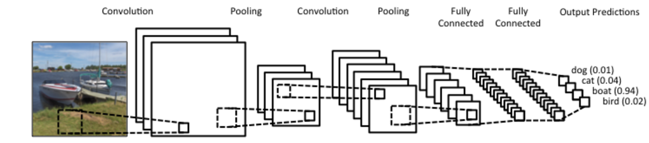
Network Architecture and Training
Goal: To find the network parameters which can minimize the average prediction log loss after the softmax layer
Weights of filters chosen by random sampling from a Gaussian distribution with zero mean and 10⁻² deviation

Slide 17
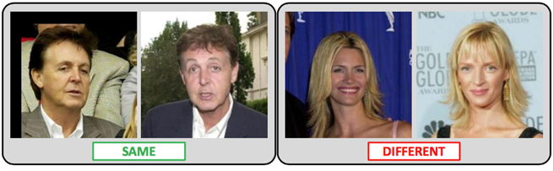
Datasets and Evaluation protocols
Evaluation is performed on existing benchmark datasets
Labelled Faces in the Wild (LFW): 13,233 images with 5,749 identities
Youtube Faces (YTF): 3,425 videos of 1,595 people
Verification accuracy and Equal Error Rate (EER): error rate at the ROC point where FP and FN rates are equal
Notes:
ROC - receiving operator characteristic

Slide 18
Implementation
MATLAB toolbox MatConvNet linked against NVIDIA CuDNN libraries to accelerate training
When face transformation is used, 2D similarity transformation is applied
Notes:
To map the face to a canonical position

Slide 19
Performance Evaluation on LFW: Triplet-loss
No. | Network Config. | Dataset | Face Align Training | Face Align Testing | Embedding | 100%-EER
1 | A | Curated | No | No | No | 92.83
2 | A | Full | No | No | No | 95.80
3 | A | Full | No | Yes | No | 96.70
4 | B | Full | No | Yes | No | 97.72
5 | B | Full | Yes | Yes | No | 97.07
6 | D | Full | No | Yes | No | 96.60
7 | B | Full | No | Yes | Yes | 99.13
Notes:
Curation didn’t help much. More data, better accuracy.
Alignment really helped with the testing data.
Architecture B performed the best. Extra convolutional layers didn’t appear to help.
Finally, the embedding boosted performance by a significant amount.

Slide 20
Conclusion
Proposed a procedure to obtain a large dataset with small label noise and involving minimum manual annotation
Proved that a deep CNN without any embellishments and with appropriate training, can achieve results comparable to the state of the art
Notes:
One of the key ideas was to use weaker classifiers to rank the data presented to the annotators.

Slide 21
Fisher Vector Faces in the Wild
Karen Simonyan, Omkar M. Parkhi, Andrea Vedaldi, Andrew Zisserman
Visual Geometry Group, University of Oxford
https://www.robots.ox.ac.uk/~vgg/publications/2013/Simonyan13/simonyan13.pdf
Notes:
Published in 2014 in BMVC (British Machine Vision Conference)
By the visual geometry group at the University of Oxford
Has achieved state of the art performance on the “Labeled faces in the wild database” - defacto evaluation benchmark

Slide 22
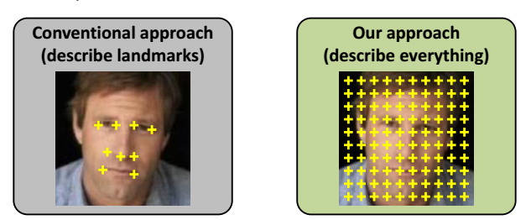
Key Points
Dense sampling
Relevant face parts learnt automatically
Compact and Discriminative
Notes:
Conventional approach - need to use landmark detection algorithm and then extract features
Challenge - dimension of such vector is high

Slide 23
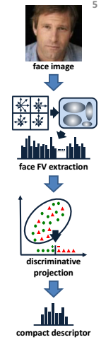
Process Overview
Input: Face Image
Deploy SIFT to extract features
26K 128-dimensional vectors
Non-linear FV encoding
Dimensionality reduction - non convex formulation
Notes:
Dimensionality reduction further increases accuracy as well - dual benefit

Slide 24

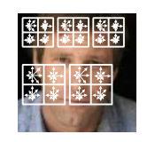
Dense SIFT
SIFT - Scale Invariant Feature Transform
Scale-invariant
Rotation-invariant
Translation-invariant
Scale-Space grid
24x24 window
1 pixel stride
5 scales
128-dim vectors -> PCA -> 64-dim
26K 64-dim feature vectors

Slide 25
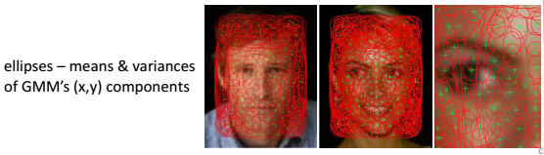
II. Fisher Vector Encoding
Describes a set of local features in a single vector
Uses diagonal covariance GMM as a codebook
GMM can be seen as a face model

Slide 26
Issue: Spatial Information
FV does not capture distribution of features in spatial domain
Spatial pyramid coding - image divided into cells - FVs of all cells stacked
Dimensionality increased with number of cells
Solution - Augment the visual features with their spatial coordinates. => [S_{xy}, x/w - 0.5; y/h - 0.5]
Notes:
Spatial information is lost with feature-only model
One way is to use spatial pyramid coding - but dimensionality increases linearly

Slide 27
III. Dimensionality Reduction
Linear projection is used
Goal: Find the projection matrix W
Non convex formulation
Reduces dimensionality drastically, thus can be used with large scale datasets.
Dual Benefit - speed and accuracy
Notes:
FV encoding is high dimensional.

Slide 28
Implementation
Face Alignment and Extraction
Viola Jones detector run on the image -> face detection
9 facial landmark positions identified
Similarity transform applied to transform the face to a canonical frame.
Extract a 160 x 125 face region around the landmarks for further processing.

Slide 29
2. Face descriptor Computation
Publicly available packages used for FV encoding, SIFT
Dimensionality reduction performed in matlab
It takes few hours for computation on a single core machine

Slide 30
3. Diagonal Metric Learning
Linear SVM is used
Features = vectors of squared differences between corresponding components of two FVs
Learning is basically performed to extract semantic face attributes as facial features which could be used for identification, etc
Notes:
diagonal metric learning on the full-dimensional Fisher vectors. It is carried
out using a conventional linear SVM formulation, where features are the vectors of squared
differences between the corresponding components of the two compared FV
Another method - Joint-metric similarity learning also used.

Slide 31
4. Horizontal Flipping
The test set is augmented.
Horizontal reflections of 2 compared images are taken.
The distances between the 4 possible combinations of the original and reflected images is averaged.

Slide 32
Evaluation
Labelled faces in the Wild dataset used
13233 images of 5749 people - considered benchmark.
Divided into 10 disjoint splits
600 predefined image pairs: 300 positive pairs (same person), 300 negative pairs (different people)
10 fold cross validation

Slide 33
Training the Data
PCA projections for SIFT
Gaussian mixture models
Discriminative Fisher vector projections
All these are trained independently for each fold

Slide 34
Evaluation Metrics
Receiving Operating Characteristic Equal Error Rate (ROC-EER)
Gives the accuracy at the ROC operating point, where false positives and false negatives rates are equal
Reflects quality of ranking obtained by scoring image pairs
Different stages of the proposed framework can be compared.

Slide 35
Final classification performance is reported in terms of classification accuracy
Classification accuracy = percentage of image pairs classified correctly

Slide 36
Evaluation Protocols
The LFW specifies 2 protocols:
Restricted setting - predefined image pairs for each split used for training
Unrestricted setting - identities within each split are given, an arbitrary number is formed for positive and negative training pairs

Slide 37
Experiments
Unrestricted setting and unaligned LFW images.
The parameters SIFT density, GMM size, effect of spatial augmentation, dimensionality reduction, distance function and horizontal flipping.
The results are summarized in the following slide

Slide 38
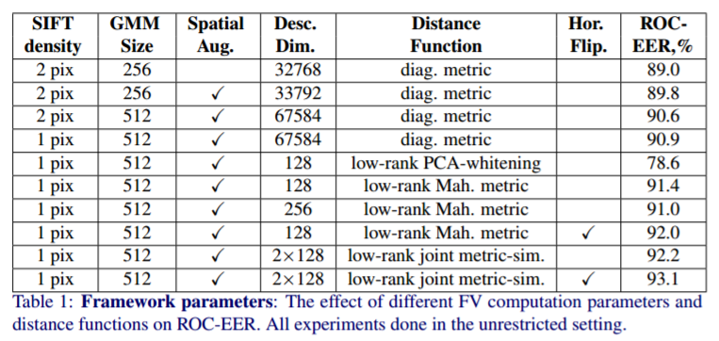

Slide 39
Observations
Performance increases with:
Denser Sampling
More clusters in GMM
Spatial augmentation (with minor increase in dimensionality)
Dimensionality reduction
Horizontal Flipping
Projection to higher dimensions - overfitting

Slide 40
Model Visualisation
Model can capture face specific features
Each GMM component corresponds to a part of the Fisher Vector and to a group of columns in the projection matrix.
Certain Gaussians are important and can be found by computing the energy of the corresponding column group

Slide 41
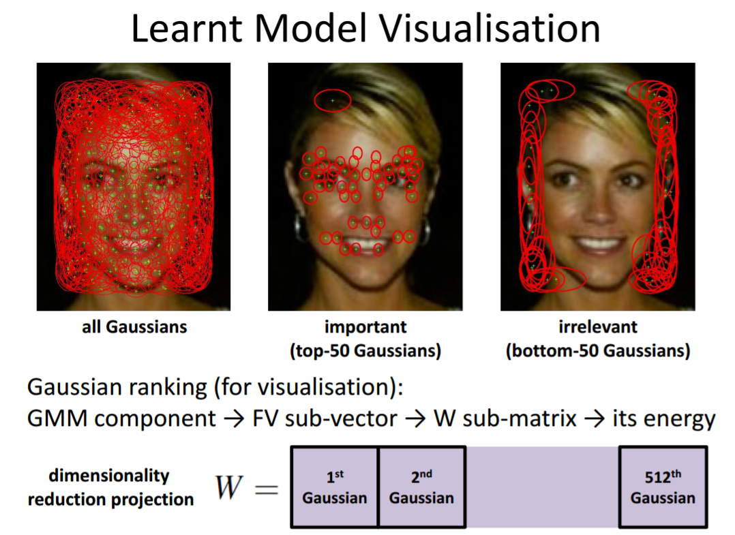
Notes:
Each Gaussian captures joint appearance-location statistics (Sect. 2), but here we only visualise the location as an ellipse with the centre and radii set to the mean and variances of the spatial components. As can be seen from Fig. 2-d, the 50 Gaussians corresponding to the columns with the highest energy match the facial features without being explicitly trained to do so. They have small spatial variances and are finely localised on the image plane. On the contrary, Fig. 2-e shows how the 50 Gaussians corresponding to the columns with the lowest energy cover the background areas. These clusters are deemed as the least meaningful by our projection learning; note that their spatial variances are large.

Slide 42
Results
For unrestricted setting:
93.03% face verification accuracy
Almost equal to state of the art (93.18%) that uses landmark detection
Author’s algorithm:
Sampled the features densely instead
10 fold cross validation

Slide 43
Results
For restricted setting:
Centred 150 x 150 crops of LFW dataset used for training.
Training data insufficient for dimensionality reduction learning, thus a diagonal metric function using SVM learnt
Verification accuracy of 87.47%
3.4% greater than the existing best.

Slide 44
Results
Even though some methods use GMMs for dense feature clustering, they do not use Fisher Vector, keeping all extracted features for matching - limitation.
Dimensionality of Fisher Vector does not depend upon the number of features it encodes.
Notes:
It should be noted that while [19] also use GMMs for dense feature clustering, they do not utilise the compressed Fisher vector encoding, but keep all extracted features for matching, which imposes a limitation on the number of features that can be extracted and stored.

Slide 45
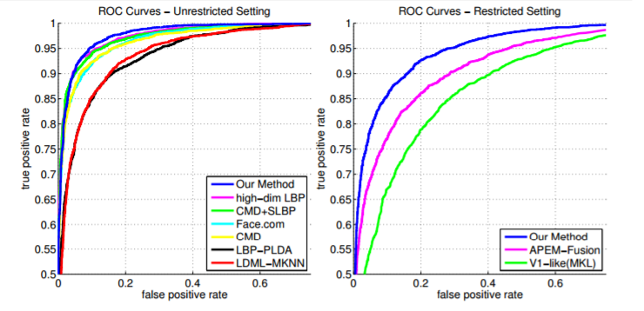
Notes:
It should be noted that while [19] also use GMMs for dense feature clustering, they do not utilise the compressed Fisher vector encoding, but keep all extracted features for matching, which imposes a limitation on the number of features that can be extracted and stored.

Slide 46
Conclusion
Use of dense features avoids applying landmark detectors
Huge dimensionality reduction
Effective and efficient face descriptor computation, thus can be used for large datasets
Future work - Handle multi-feature image representations for which a framework is already in place
Notes:
It should be noted that while [19] also use GMMs for dense feature clustering, they do not utilise the compressed Fisher vector encoding, but keep all extracted features for matching, which imposes a limitation on the number of features that can be extracted and stored.

Slide 47


